Slide 1
Chapter 20 – Heredity and Genetics

Slide 2
20.1 Genetics – An Introduction
You should be able to:
■ explain the meaning of the terms gene, allele, dominant, recessive, genotype, phenotype; and
■ use genetic diagrams to explain the inheritance of a single pair of characteristics.

Slide 3
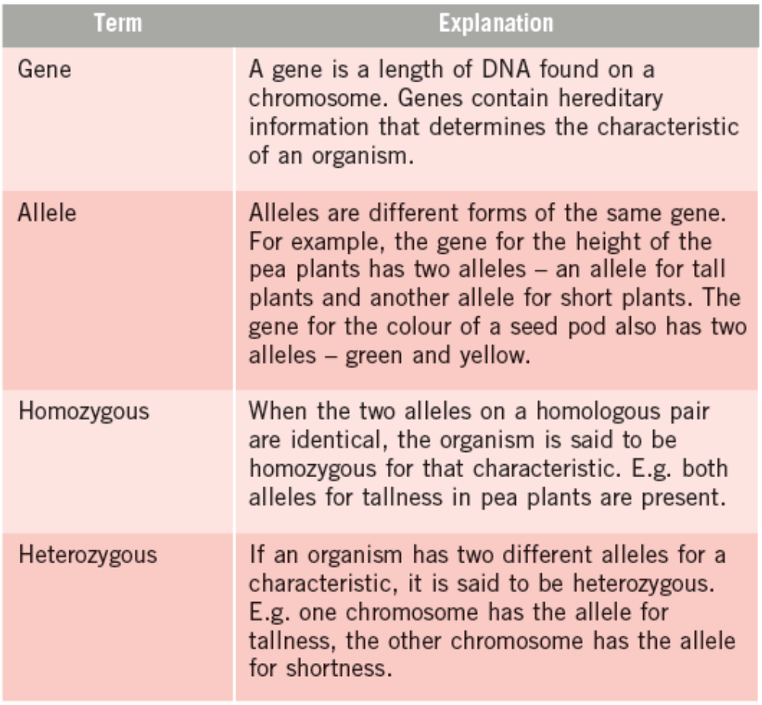
20.1 Genetics – An Introduction
Genetic Terms

Slide 4
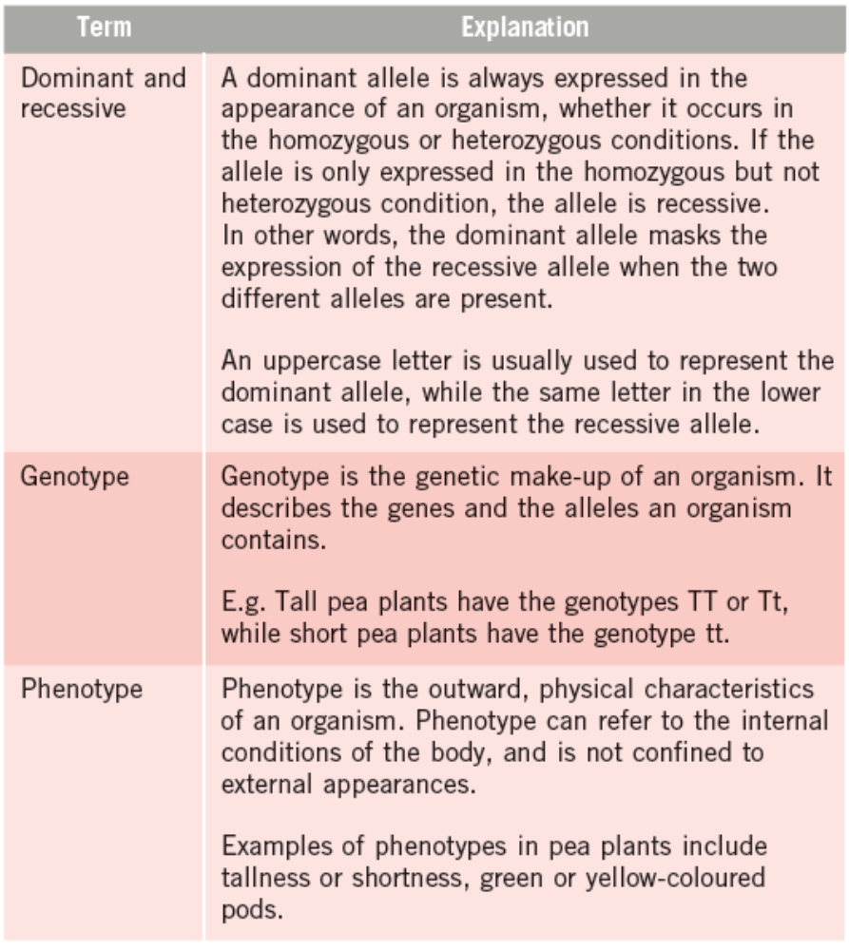
20.1 Genetics – An Introduction

Slide 5
20.1 Genetics – An Introduction
The Father of Classical Genetics
Gregor Mendel studied monohybrid inheritance in peas.
From his experiments, he found that:
When a pure breeding tall plant is crossed with a pure breeding dwarf plant, all the resulting offspring are tall. These offspring are known as the first filial, or F₁ generation.
When the F1 plants were crossed with other F1 plants, the offspring (known as the second filial or F₂ generation) are always in an approximate ratio of three tall plants to one dwarf plant.

Slide 6
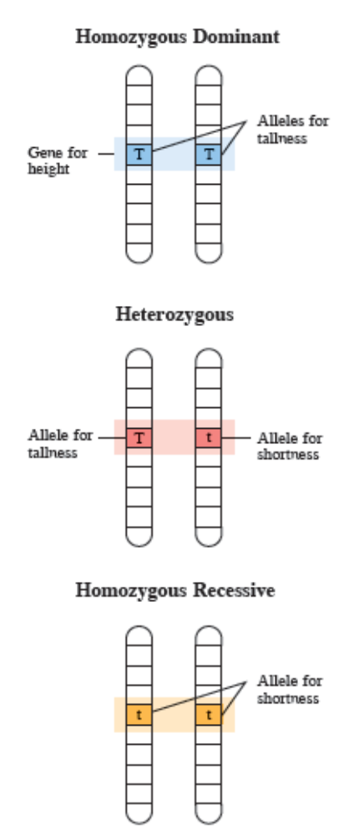
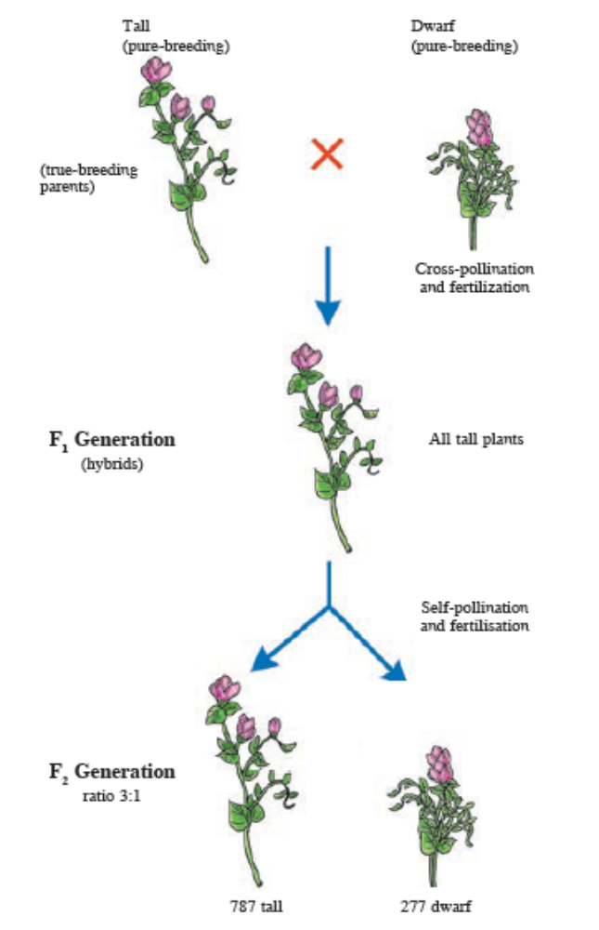
20.1 Genetics – An Introduction
Possible combinations of alleles for height of pea plants on homologous chromosomes.

Slide 7
20.1 Genetics – An Introduction
Mendel made an important deduction from his observations:
  Each character is determined by a pair of factors (now known as alleles).
  The two factors in each pair separate or segregate during gamete formation and each will contain one factor. This is known as the law of segregation, or Mendel’s first law.

Slide 8
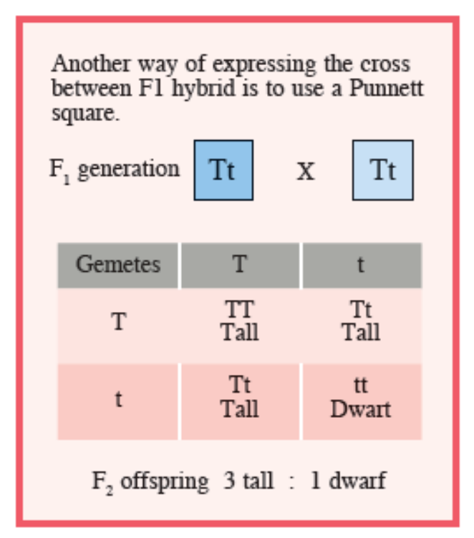
20.1 Genetics – An Introduction
The Punnett Square is a convenient method of determining the results of the random combination of the male and female gametes.

Slide 9
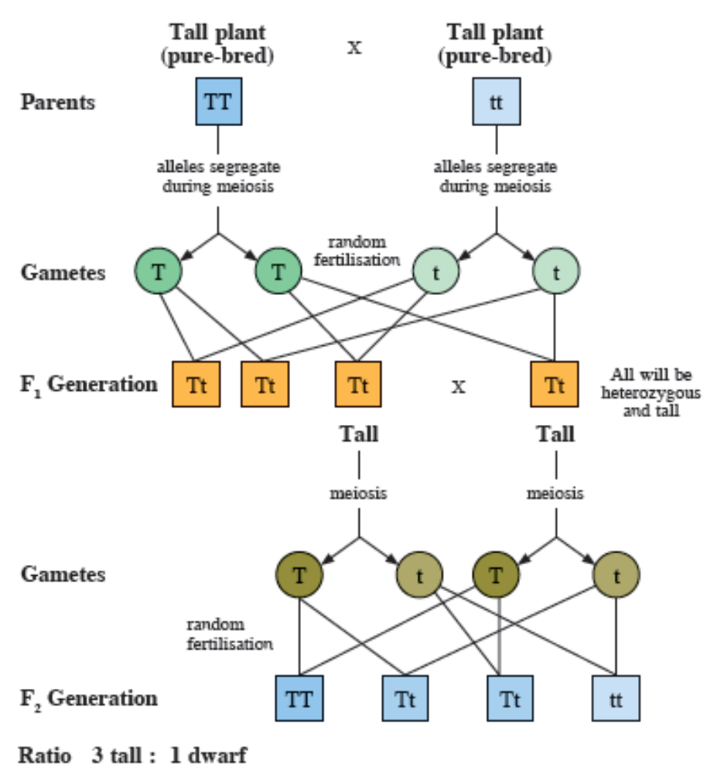
20.1 Genetics – An Introduction
Cross between two pure bred pea plants – tall and dwarf, and the cross between the F₁ hybrids.

Slide 10
20.1 Genetics – An Introduction
Why Actual Ratios Differ from Expected Ratios
Take the example of the F1 hybrids with genotype Tt, which produces 50% t-gametes and 50% T-gametes. Since the fusion of gametes is a chance event, there is a chance that more male t-gametes fuse with female t-gametes than expected. This deviation from expected proportions is very evident for small numbers of offspring.
Not all the offspring, or gametes produced, will survive, or germinate, in the case of plants.

Slide 11
20.2 Monohybrid Inheritance
You should be able to:
■ use a test cross to determine an unknown genotype;
■ explain incomplete dominance, co-dominance and multiple alleles;
■ describe the mechanism of sex determination in humans; and
■ understand and analyse pedigree charts.

Slide 12
20.2 Monohybrid Inheritance
Test Cross
In order to find out the genotype of an organism with a dominant trait, a test cross needs to be carried out.
The unknown organism is crossed with an organism displaying the recessive phenotype of the same characteristic.

Slide 13
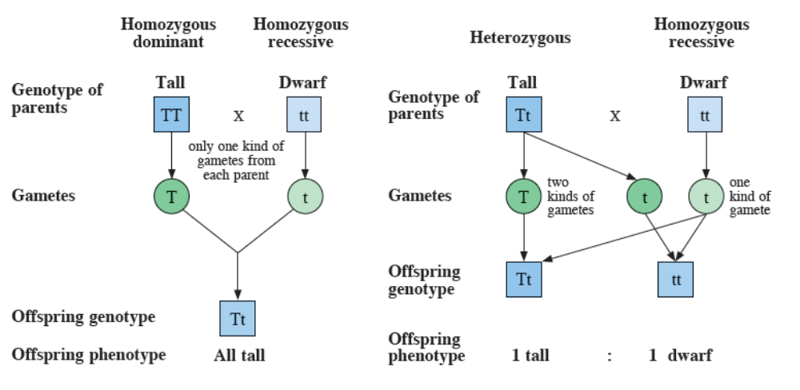
20.2 Monohybrid Inheritance
If the organism is homozygous dominant (TT), then all the offspring will be heterozygous (Tt), displaying the dominant trait (tall plants).
If the organism is heterozygous, then half the offspring will be heterozygous (Tt) and show the dominant trait, while the other half will be homozygous (tt) and show the recessive trait.

Slide 14
20.2 Monohybrid Inheritance
Incomplete Dominance and Co-dominance
Incomplete dominance occurs when neither allele is completely dominant over the other allele.
It leads to a phenotype that is an intermediate between that of the parents.
E.g. The snapdragon plant. One allele (represented by C^{R}) produces red flowers, and the other allele (represented by C^{W}) produces white flowers. When homozygous red flowers and homozygous white flowers are crossed, pink flowers (C^{R}C^{W}) are produced. When the pink flowers of snapdragon are crossed among themselves, a phenotypic ratio of 1 red : 2 pink : 1 white results.

Slide 15
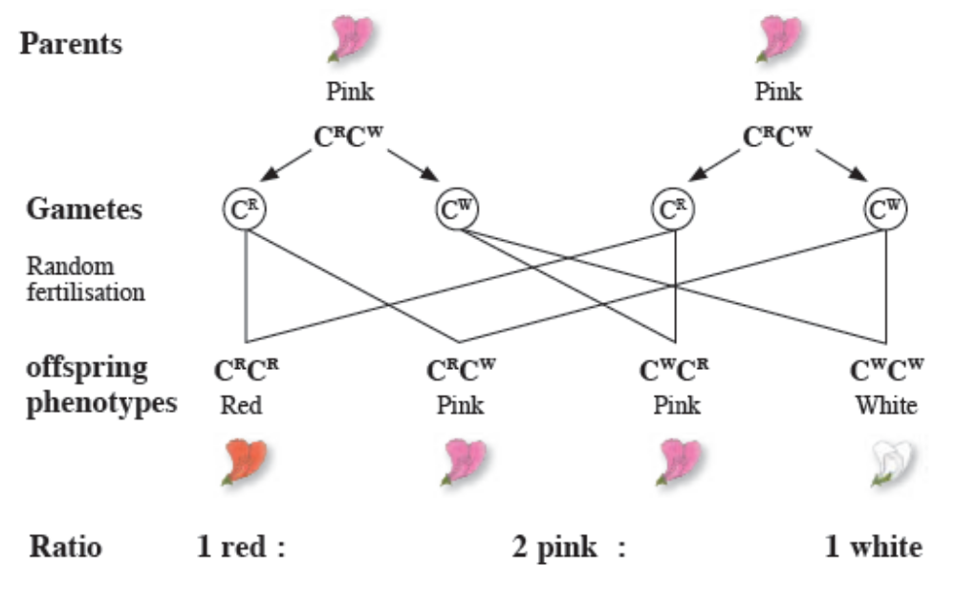
20.2 Monohybrid Inheritance

Slide 16
20.2 Monohybrid Inheritance
Co-dominance
Occurs when both alleles are equally expressed in the heterozygous condition.
An example of codominance can be seen in the short-horned cattle.
The offspring of a homozygous red bull and a homozygous white cow will be roan with a mixture of red and white hairs.
Another example of co-dominance is the ABO blood groups in humans.

Slide 17
20.2 Monohybrid Inheritance
Multiple alleles
There can be several different possible combinations of alleles in an individual.
The ABO system is controlled by three alleles – I^{A} (blood group A), I^{B} (blood group B) and I^{O} (blood group O). The alleles I^{A} and I^{B} are co-dominant, and both alleles are dominant over I^{O} .

Slide 18
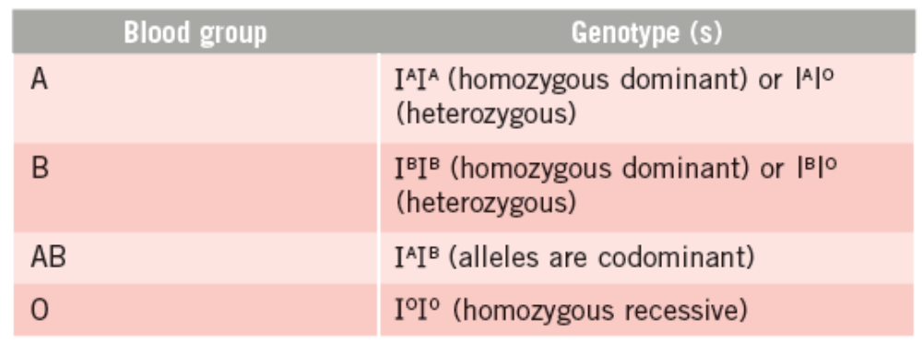
20.2 Monohybrid Inheritance
The four ABO blood groups and their respective genotypes.

Slide 19
20.2 Monohybrid Inheritance
Sex determination in Humans
Humans have 22 pairs of autosomes and one pair of sex chromosomes (XX or XY) in each cell.
Females have two X chromosomes. Each ovum has one X chromosome.
Half of the sperm produced by males have the X chromosome, while the other half have the Y chromosome.
The possibility of getting a male or female offspring is 50%.

Slide 20
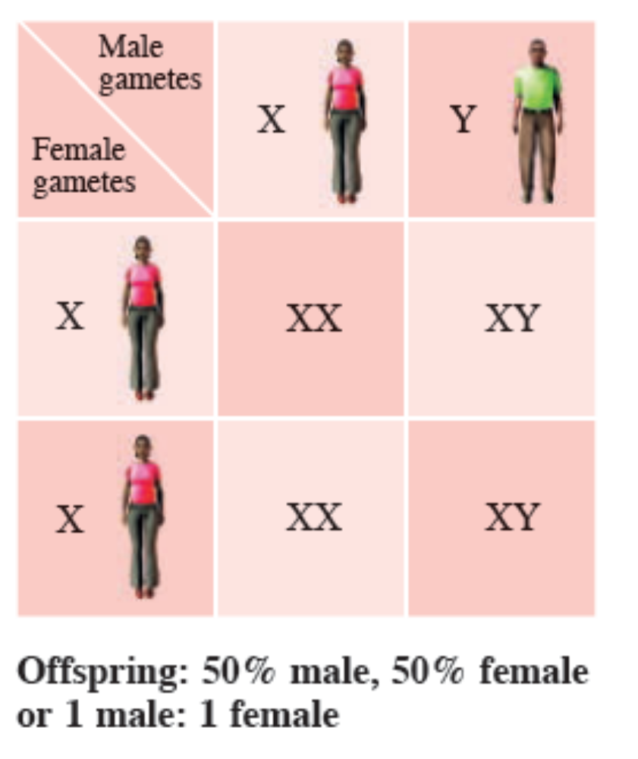
20.2 Monohybrid Inheritance

Slide 21
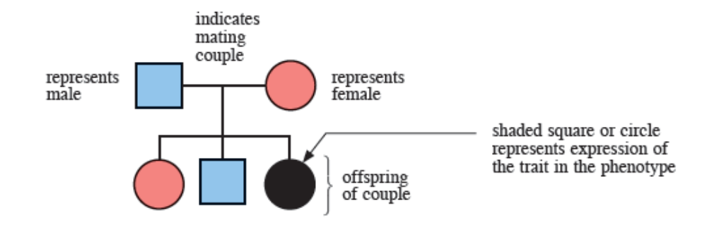
20.2 Monohybrid Inheritance
Pedigree analysis
Pedigrees are a set of diagrams tracing the inheritance of a trait among related individuals.
A pedigree chart and what the symbols represent

Slide 22
20.2 Monohybrid Inheritance
Guidelines for pedigree analysis
  If two unaffected parents have an affected offspring, the allele for the condition is recessive.
  If two affected parents have an unaffected offspring, the allele for the condition is dominant.
  For a dominant trait, there will be individuals exhibiting that trait in every generation in the family.
  For a recessive trait, the trait may skip a generation before it is expressed.

Slide 23
Key Concepts
Genes are found on chromosomes and are the basic units of inheritance.
When the alleles are the same in a pair of chromosomes, the organism is homozygous for the trait. If the alleles are different, the organism is heterozygous.
A dominant allele will always be expressed even in the presence of a recessive allele. A recessive allele can only be expressed in the homozygous state, in the absence of dominant alleles.
The phenotype refers to the outward appearance of an organism, while genotype refers to the genetic make-up of the organism.

Slide 24
Key Concepts
A cross between two pure-breeding organisms results in heterozygous offspring. When these offspring are crossed, the resulting phenotypic ratio will be 3 (dominant trait): 1 (recessive trait).
A test cross involves crossing an organism of unknown genotype with a homozygous recessive individual.
Incomplete dominance results when two alleles controlling a characteristic are not completely dominant over each other.
There is an equal chance of obtaining a daughter or a son for each fertilisation event in humans.

